Slide 1



Youth Ministries
AUC Constituency Meeting 2025

Slide 2
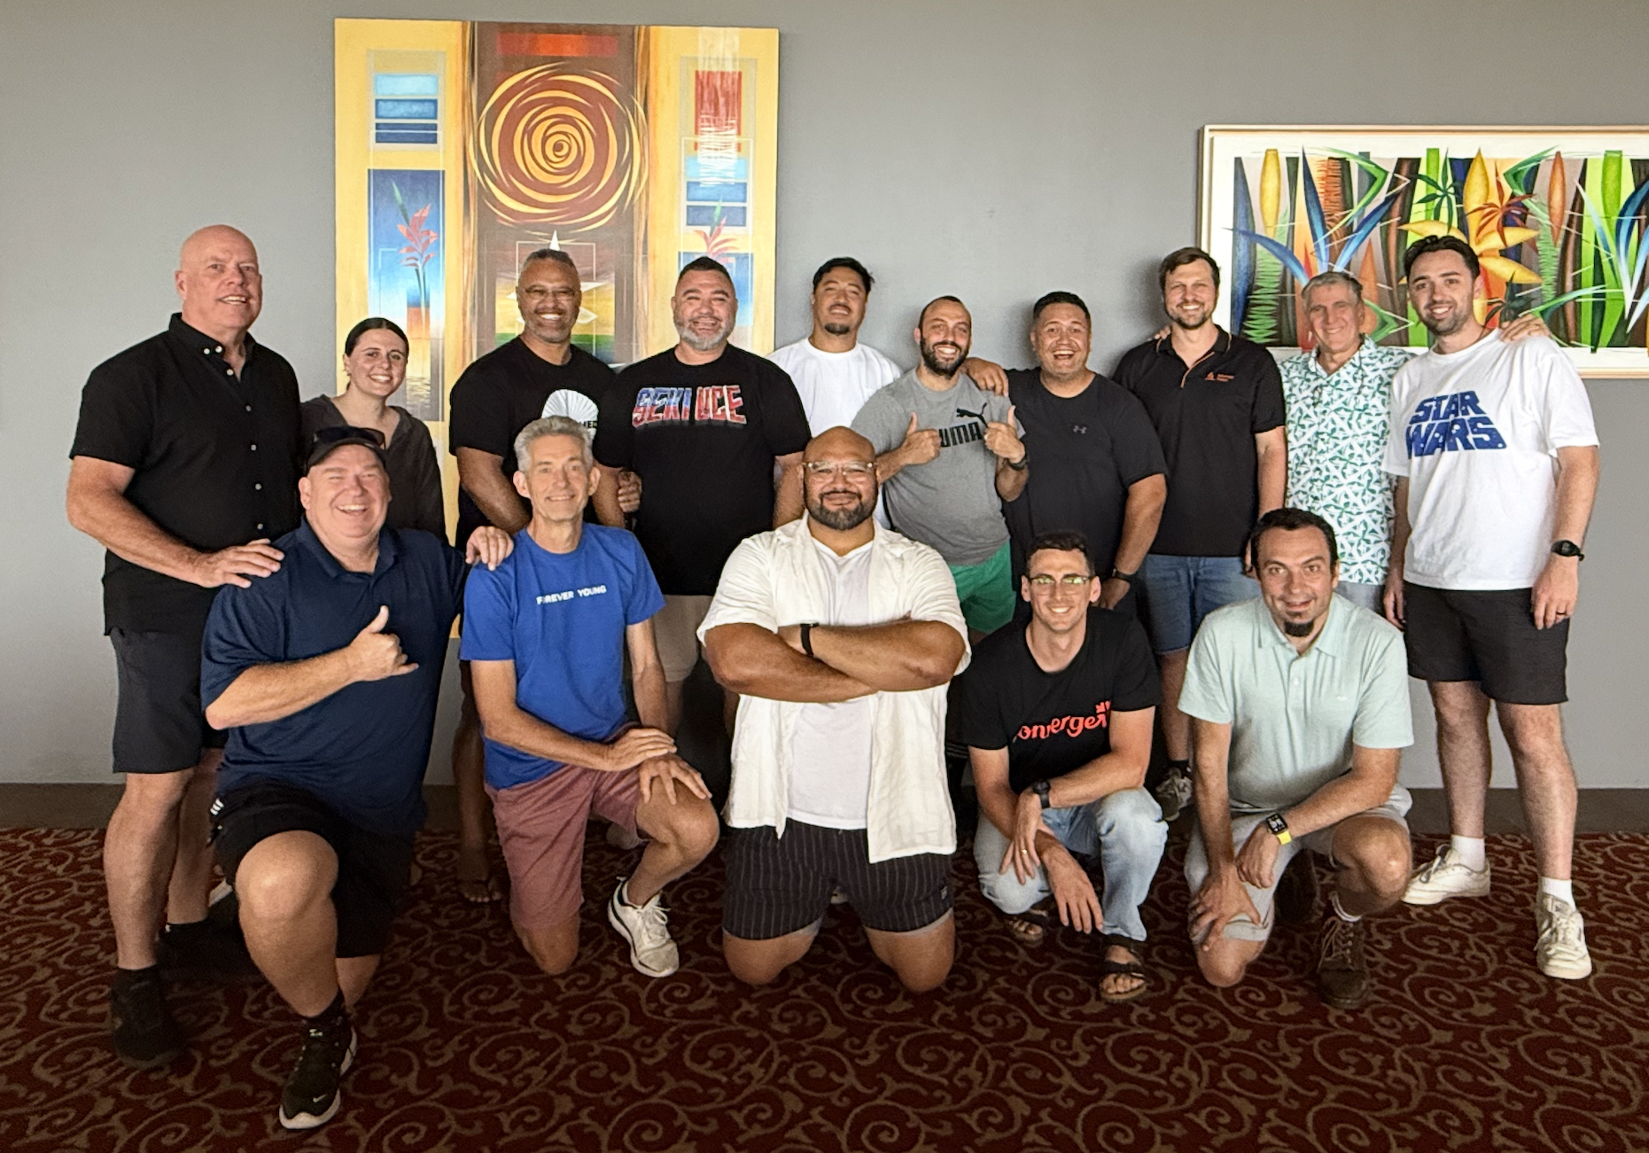

Slide 3

Adventurer Growth of 16%
this quinquennium
2019
160 clubs
Total members 2775
2025
187 clubs
Total members 3234
An addition of 27 clubs
and an increase of 459 Adventurers

Slide 4
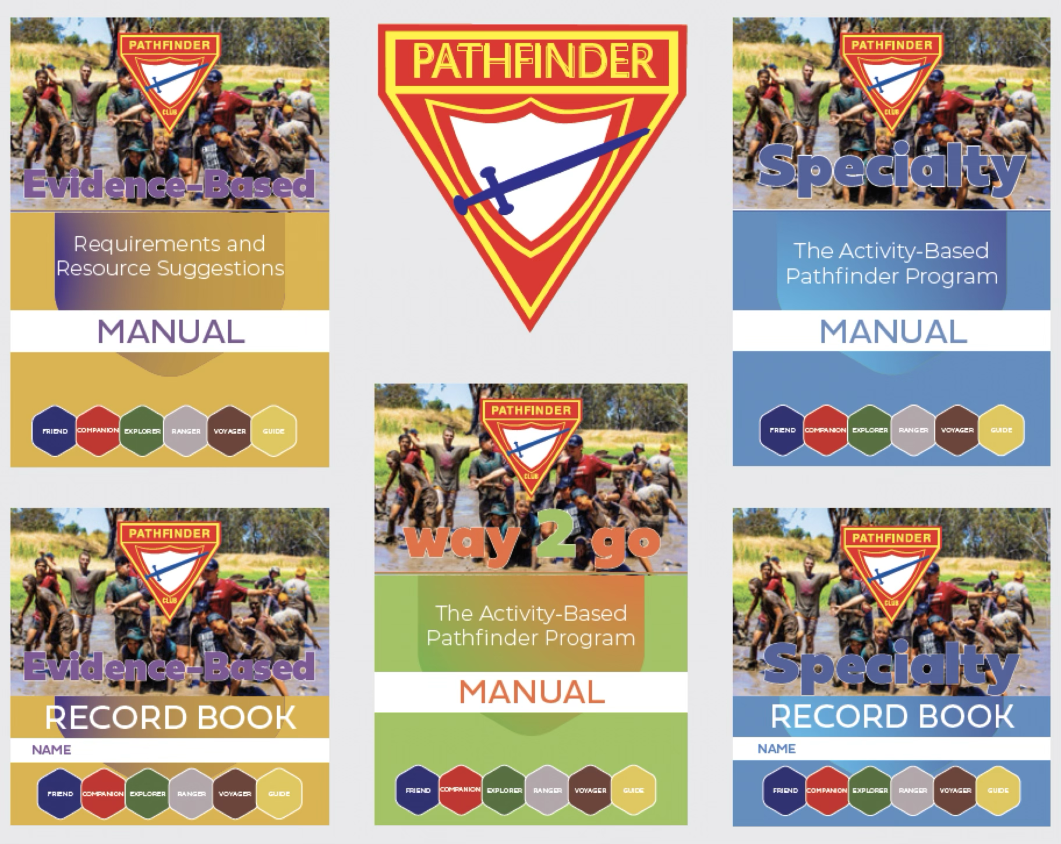
Pathfinder Growth of 12%
this quinquennium
2019
165 clubs
Total members 3942
2025
192 clubs
Total members 4392
An addition of 27 clubs
and an increase of 450 Pathfinders

Slide 5


Slide 6
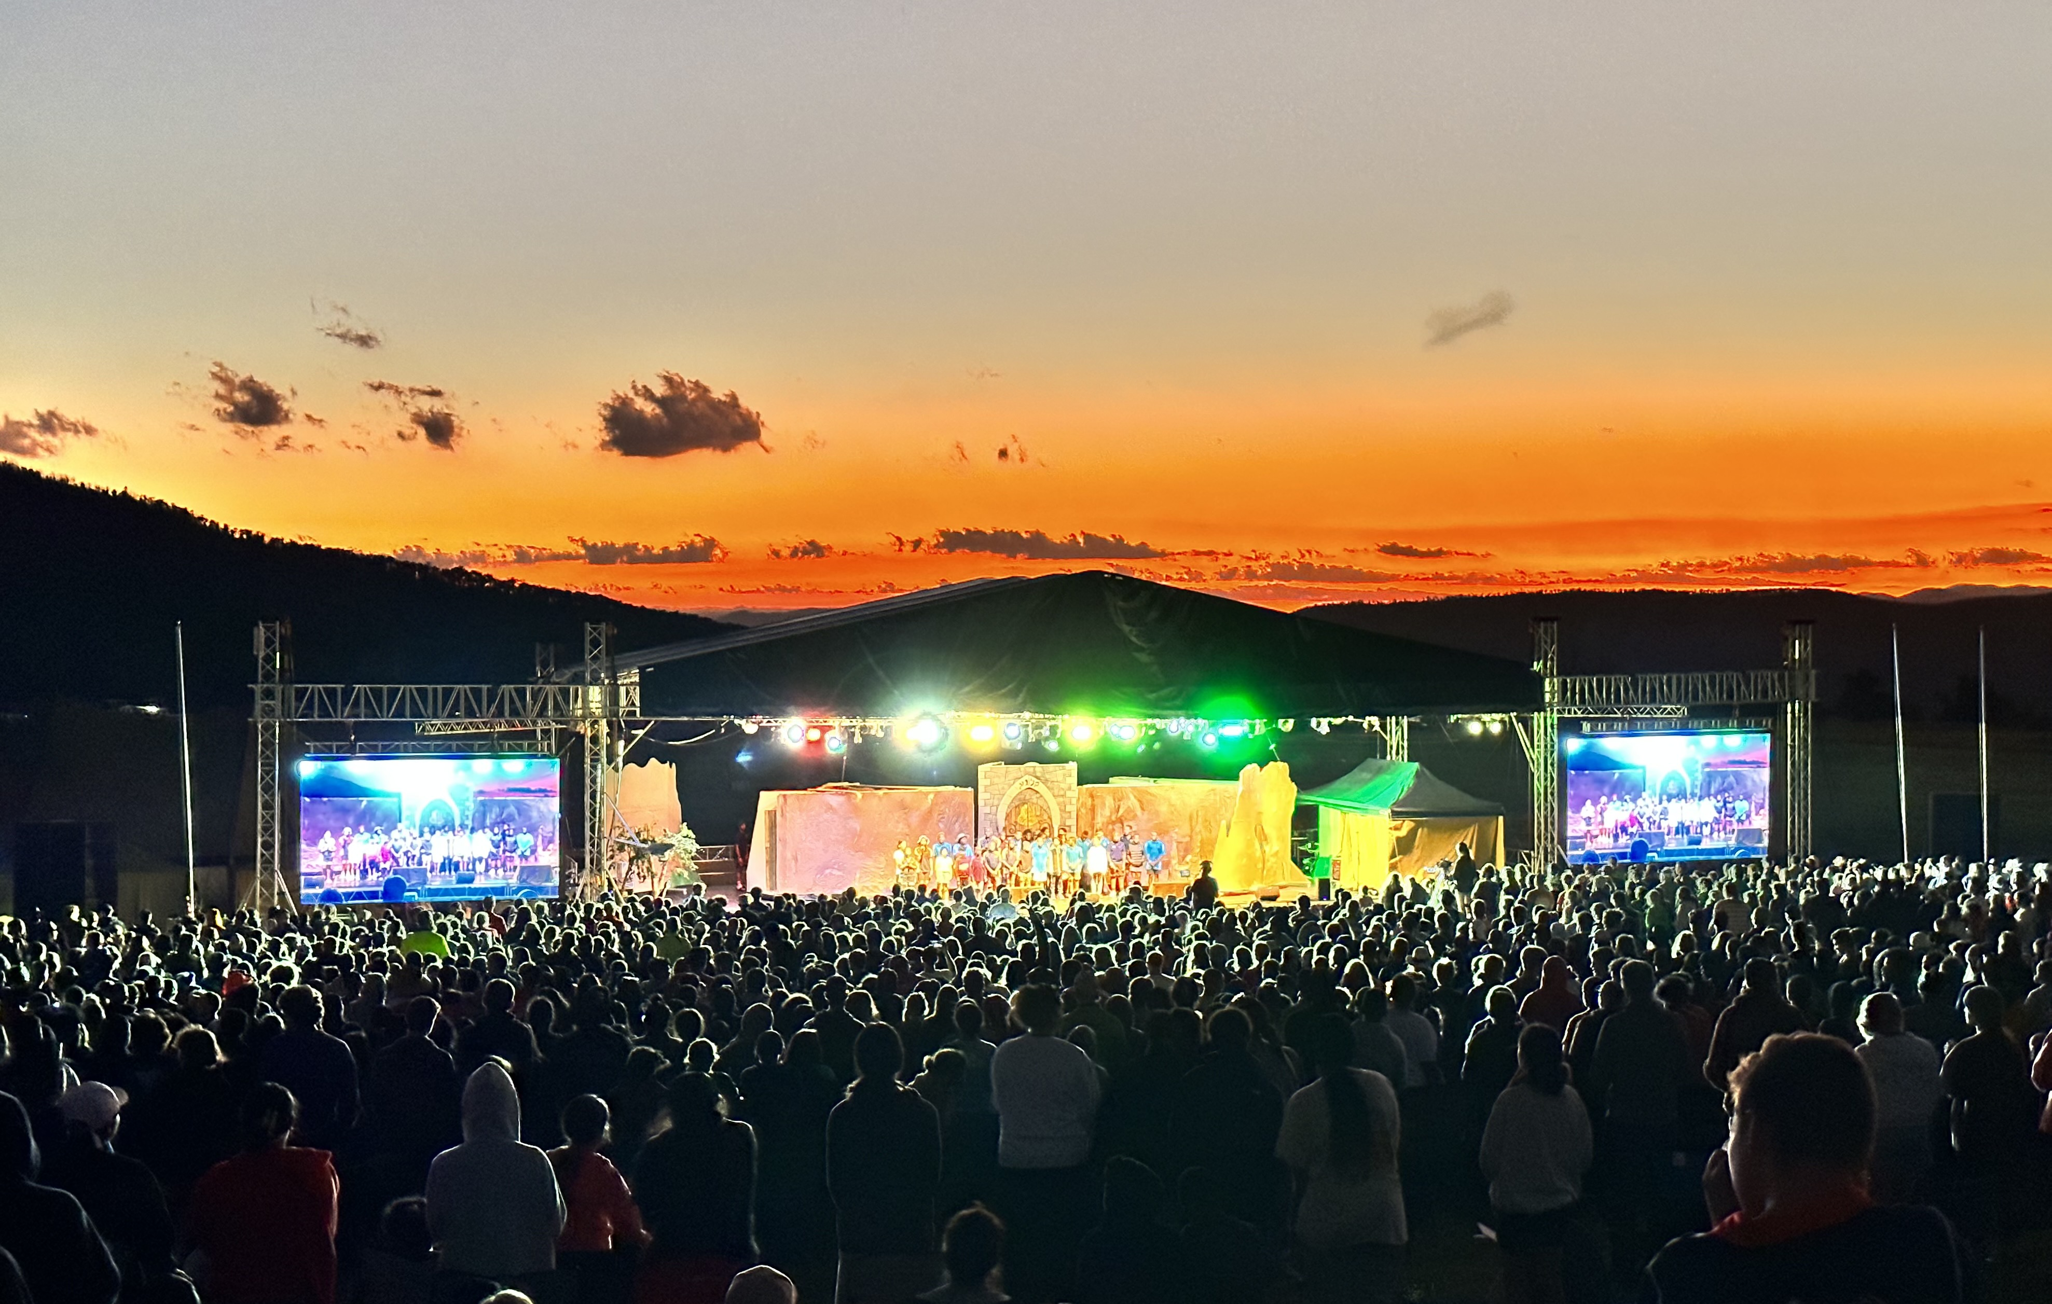

Slide 7


Slide 8


Slide 9
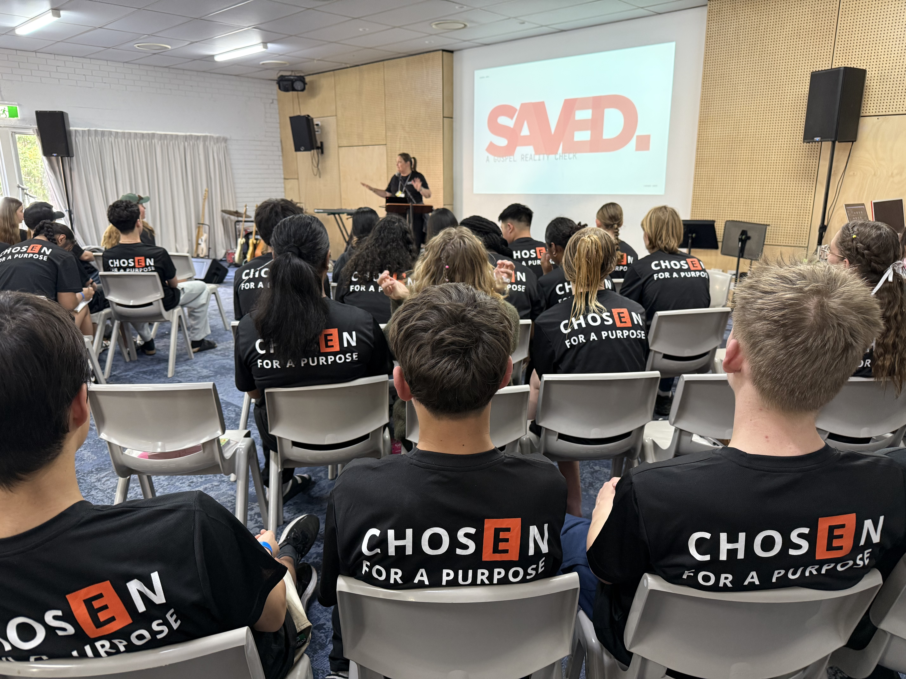
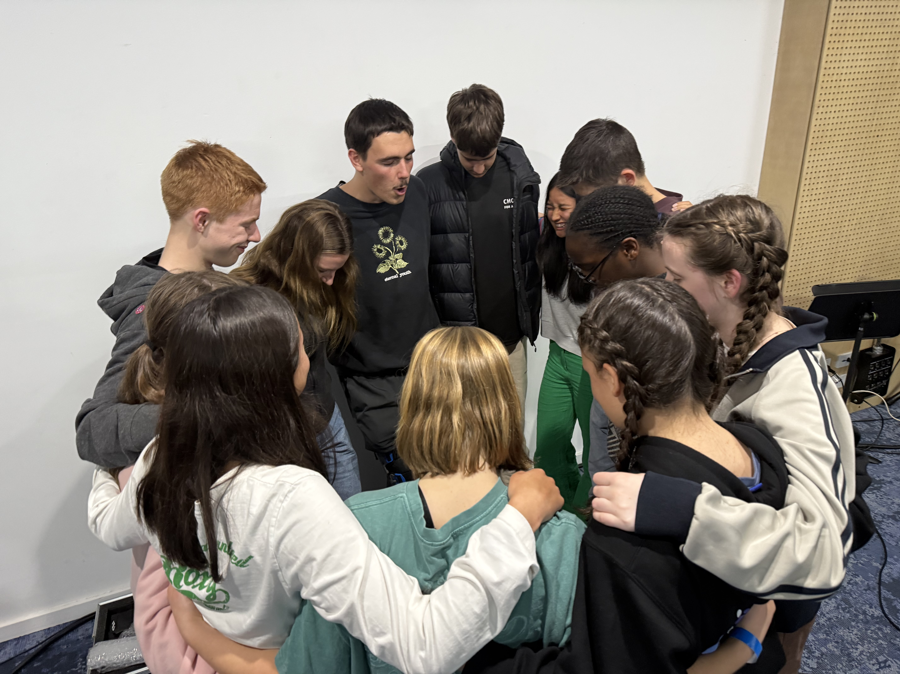

CHOSEN

Slide 10
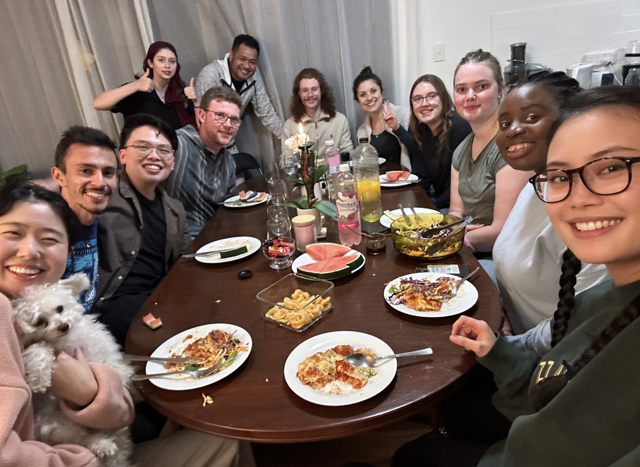
Life Groups in Secular Universities
2025
We’ve grown to
11 life groups within secular universities in Australia.
Our goal is to grow to
14 life groups over the
next 10 months.
This will greatly impact youth and young adults retention for Adventist attendees of these universities.

Slide 11


Research
Completion of my
Doctor of Ministry
Collaboration with SPD
with summary documents
3 AREAS of focus from
research - conclusions
Stronger Families
Greater emphasis on
Intergenerational
Connections in local
church
Growth of Mentoring
(particularly informal mentoring)

Slide 12
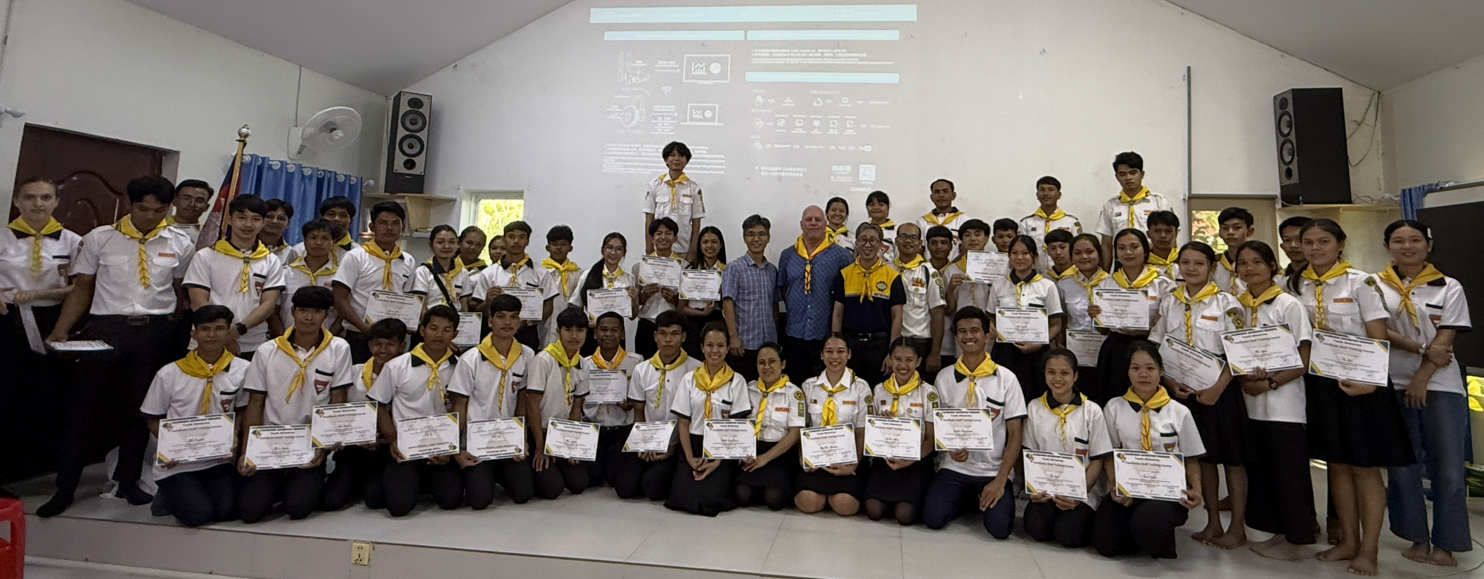
Mission Partnership

Slide 13

A full “menu” of ideas and options for helping our youth and young adults reach their mates for Jesus.
A full training package to go with the “menu”.
Working alongside our conference youth teams to offer an Australia for Christ training schedule within their conference – as needed.

Slide 14
Continue to pray
for our younger generations
as they face the world in
2025 and beyond

Slide 15


